Slide 1
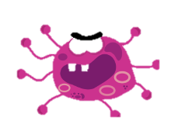
Stop The Spread And Stay Healthy!

Slide 2
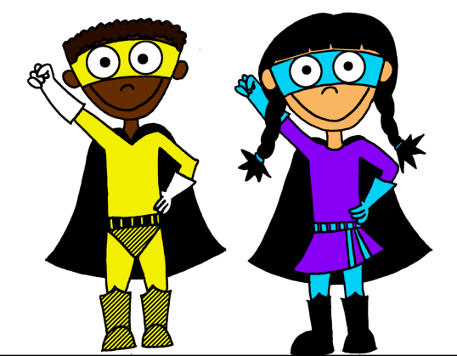
Why do we need to take more care?
Everyone needs to help to stop the spread of a new virus called – Coronavirus. This causes a disease known as ‘covid-19’.
We need to take more care to look after ourselves but also so as we do not spread this virus to other people and make them feel unwell.
We also need to try to help the doctors and nurses in the hospitals. They need the number of people going into hospital to go down so as they can make sure they can care for everyone.
We need to be superheroes and play our part!

Slide 3
How do we catch coronavirus?
The scientists think that the virus is spread by getting close to people who have the virus or by touching surfaces that may have the virus on because someone with the virus has coughed or sneezed over it.
When ever we cough or sneeze, tiny droplets of saliva (liquid in our mouth) leaves our body.
This saliva may contain germs. These can travel up to 2m away from us.
They can also settle onto dry surfaces and live for a few hours, making them ready to find a new home in your body!
That is why we have our rules around coughing and sneezing.
All our adults are also making sure surfaces are cleaned regularly and our resources are kept clean.

Slide 4
What do we need to do?

Slide 5
This means we need to think carefully about:
Using the toilets in school
not too many people in there at once (adults in school will monitor this more carefully)
Not using the sink directly next to someone else.
Waiting our turn to go in and out.
2) Spacing out in classrooms – staying in our spaces.
Adults will organise this for us.
3) Giving more space in the cloakroom area and the hall when queuing for lunch – the markings on the floor will help us do this.
4) Games we are playing – both in and out of school
* Great playground games and activities to play are on the next slide!!

Slide 6
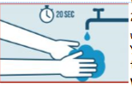
Games to play and activities for outside
Skipping – using an individual skipping rope
Hula hooping
Hide and seek
Shadow tag (on a sunny day)
Football – non contact
Hopscotch
What’s the time Mr Wolf (spread out well!)
Throw and Catch games with balls and beanbags.
*Playing on the school field – keeping the distance apart
REMEMBER: We will wash our hands when we come back inside.

Slide 7
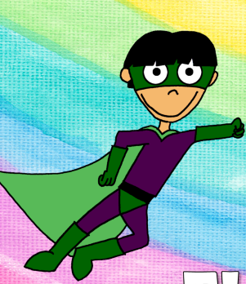
Washing our hands regularly – our number one super-power to beat the virus!
We need to make sure we:
1) Always use soap and water, rubbing our hands together as the pictures show to loosen the germs and wash them away.
2) Take responsibility for doing this – we know it so do it!
3) Let the adults know if the soap runs out so as they can refill it.

Slide 8
Nothing new here!!
Please make sure that you are always catching your cough or sneezes in a tissue or into your arm. This helps to reduce the number of droplets you send into the air and helps us fight all sorts of germs.
The adults in school will make sure there are more tissues available.
REMEMBER TO WASH YOUR HANDS STRAIGHT AFTER!
Remember if you are feeling unwell and have any of the symptoms of the virus YOU MUST STAY AT HOME.

Slide 9
The clever scientists believe that the virus can be spread by touching surfaces where people may have coughed or sneezed tiny droplets onto and then touching our faces.
Our eyes, nose and mouth are like doorways in to our bodies. Germs like to get in that way!
We must remember to not touch our faces – it is surprising how much we do!
Keep your hands busy with a fiddle toy or pencil/pen
Tie your hair up or back with a head band
Wear your glasses (if you need them!)
Ask your friend to remind you not to touch your face.

Slide 10
So be a good superhero and play your part!
If you would like to know more about the Coronavirus visit:
https://www.elsa-support.co.uk/coronavirus-story-for-children/
https://www.bbc.co.uk/newsround/51204456

